Slide 1
Predicting Customer Success
Group 4
Chase Jensen | Hobeen Moon | Joey Chen | Nik Sassen

Slide 2




Business Problem
How do we best identify what a successful business is?
No clear criteria for what a makes a successful customer.
Approach was to identify characteristics of current successful customers.
Chose to model customer success using Customer Tiering alongside predictive analytics.
Notes:
Chase
With 10% of their business coming from the performance of local businesses,
Swire Coca-cola is looking for a way to determine which potential customers will
be the most successful. With a method in place to predict the success of
customers, Swire will be able to select the best businesses to sell too.
This will allow for Swire to set prices that benefit both themselves and the
businesses and also maximize potential ROI. There are not any immediate success
metrics that we can measure, so determining success will take some time.
However, after a certain amount of time, success can be determined by the
revenue and traffic the store brings in.
The main focus of this project is to assist Swire Coca-Cola in identifying successful potential business partners.
With a sizable amount of business coming from the performance of local companies, it is important to identify current and predict future successful partners.
There is not a catch-all customer success metric, so creating a way to capture customer success is key to addressing the business problem at hand.

Slide 3






Data Preparation
Non-historical data.
Onboarding date.
Remove data with 0 or negative invoice price.
Find external data related to customer.
Target variable.
Features included in ML model.
Notes:
Non-historical data: data from customer.
CUSTOMER_NUMBER_BLINDED, SALES_OFFICE_DESCRIPTION, DELIVERY_PLANT_DESCRIPTION, ON_BOARDING_DATE, ADDRESS_CITY, ADDRESS_ZIP_CODE, COUNTY, GEO_LONGITUDE, GEO_LATITUDE, CUSTOMER_ACTIVITY_CLUSTER_DESCRIPTION, CUSTOMER_TRADE_CHANNEL_DESCRIPTION, CUSTOMER_SUB_TRADE_CHANNEL_DESCRIPTION, BUSINESS_TYPE_EXTENSION_DESCRIPTION, MARKET_DESCRIPTION, COLD_DRINK_CHANNEL_DESCRIPTION, INVOICE_PRICE
On boarding date : 2018 ~ 2020
External Data: use census data to get population, and median income. Tried using yelp api, and need the actual name of the customer to get ratings. Show example of the result.
Summary of sum_invoive_price :
Min 14
1st qu 1800
Median 5500
Mean 17000
3rd qu 14000
Max 5,625,688
Target Variable: sum invoice price
Tier by sum invoice price
TierD 0 ~ 1500
TierC 1500 ~ 10000
TierB 10000 ~ 25000
TierA < 25000
Final features:
"SALES_OFFICE_DESCRIPTION",
"DELIVERY_PLANT_DESCRIPTION",
"CUSTOMER_ACTIVITY_CLUSTER_DESCRIPTION",
"CUSTOMER_TRADE_CHANNEL_DESCRIPTION",
"CUSTOMER_SUB_TRADE_CHANNEL_DESCRIPTION",
"BUSINESS_TYPE_EXTENSION_DESCRIPTION",
"MARKET_DESCRIPTION",
"COLD_DRINK_CHANNEL_DESCRIPTION",
"POPULATION",
"MEDINCOME",
"TIER"

Slide 4
Predictor Variables
SALES_OFFICE_DESCRIPTION
DELIVERY_PLANT_DESCRIPTION
CUSTOMER_ACTIVITY_CLUSTER_DESCRIPTION
CUSTOMER_TRADE_CHANNEL_DESCRIPTION
CUSTOMER_SUB_TRADE_CHANNEL_DESCRIPTION
BUSINESS_TYPE_EXTENSION_DESCRIPTION
MARKET_DESCRIPTION
COLD_DRINK_CHANNEL_DESCRIPTION
POPULATION
MEDINCOME

Slide 5




Model
Used XGBoost for machine learning model.
7:3 train test split.
Eval_metric – mlogloss.
Cv.nfold = 5.
Notes:
Hobeen
"mlogloss" stands for "multi-class logarithmic loss," which is an evaluation metric used to measure the performance of a classification model that predicts multiple classes.

Slide 6
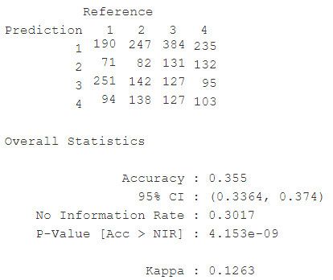

Model Evaluation
Notes:
Joey
The confusion matrix shows the model's performance in predicting four classes. The overall accuracy of the model is 35.5%, which is slightly better than the no information rate of 30.1%. The Kappa score is 0.1263, indicating fair agreement between the model's predictions and the actual values.
Sensitivity: The model has higher recall for class 1 and class 3, indicating that it is good at correctly identifying instances belonging to tier A and tier C.
In summary, the model has an overall accuracy slightly better than chance, with fair agreement with the actual values. Value counts of tier:
Tier A 12.24%
Tier B 21.7%
Tire C 43.8%
Tire D 22.1%

Slide 7
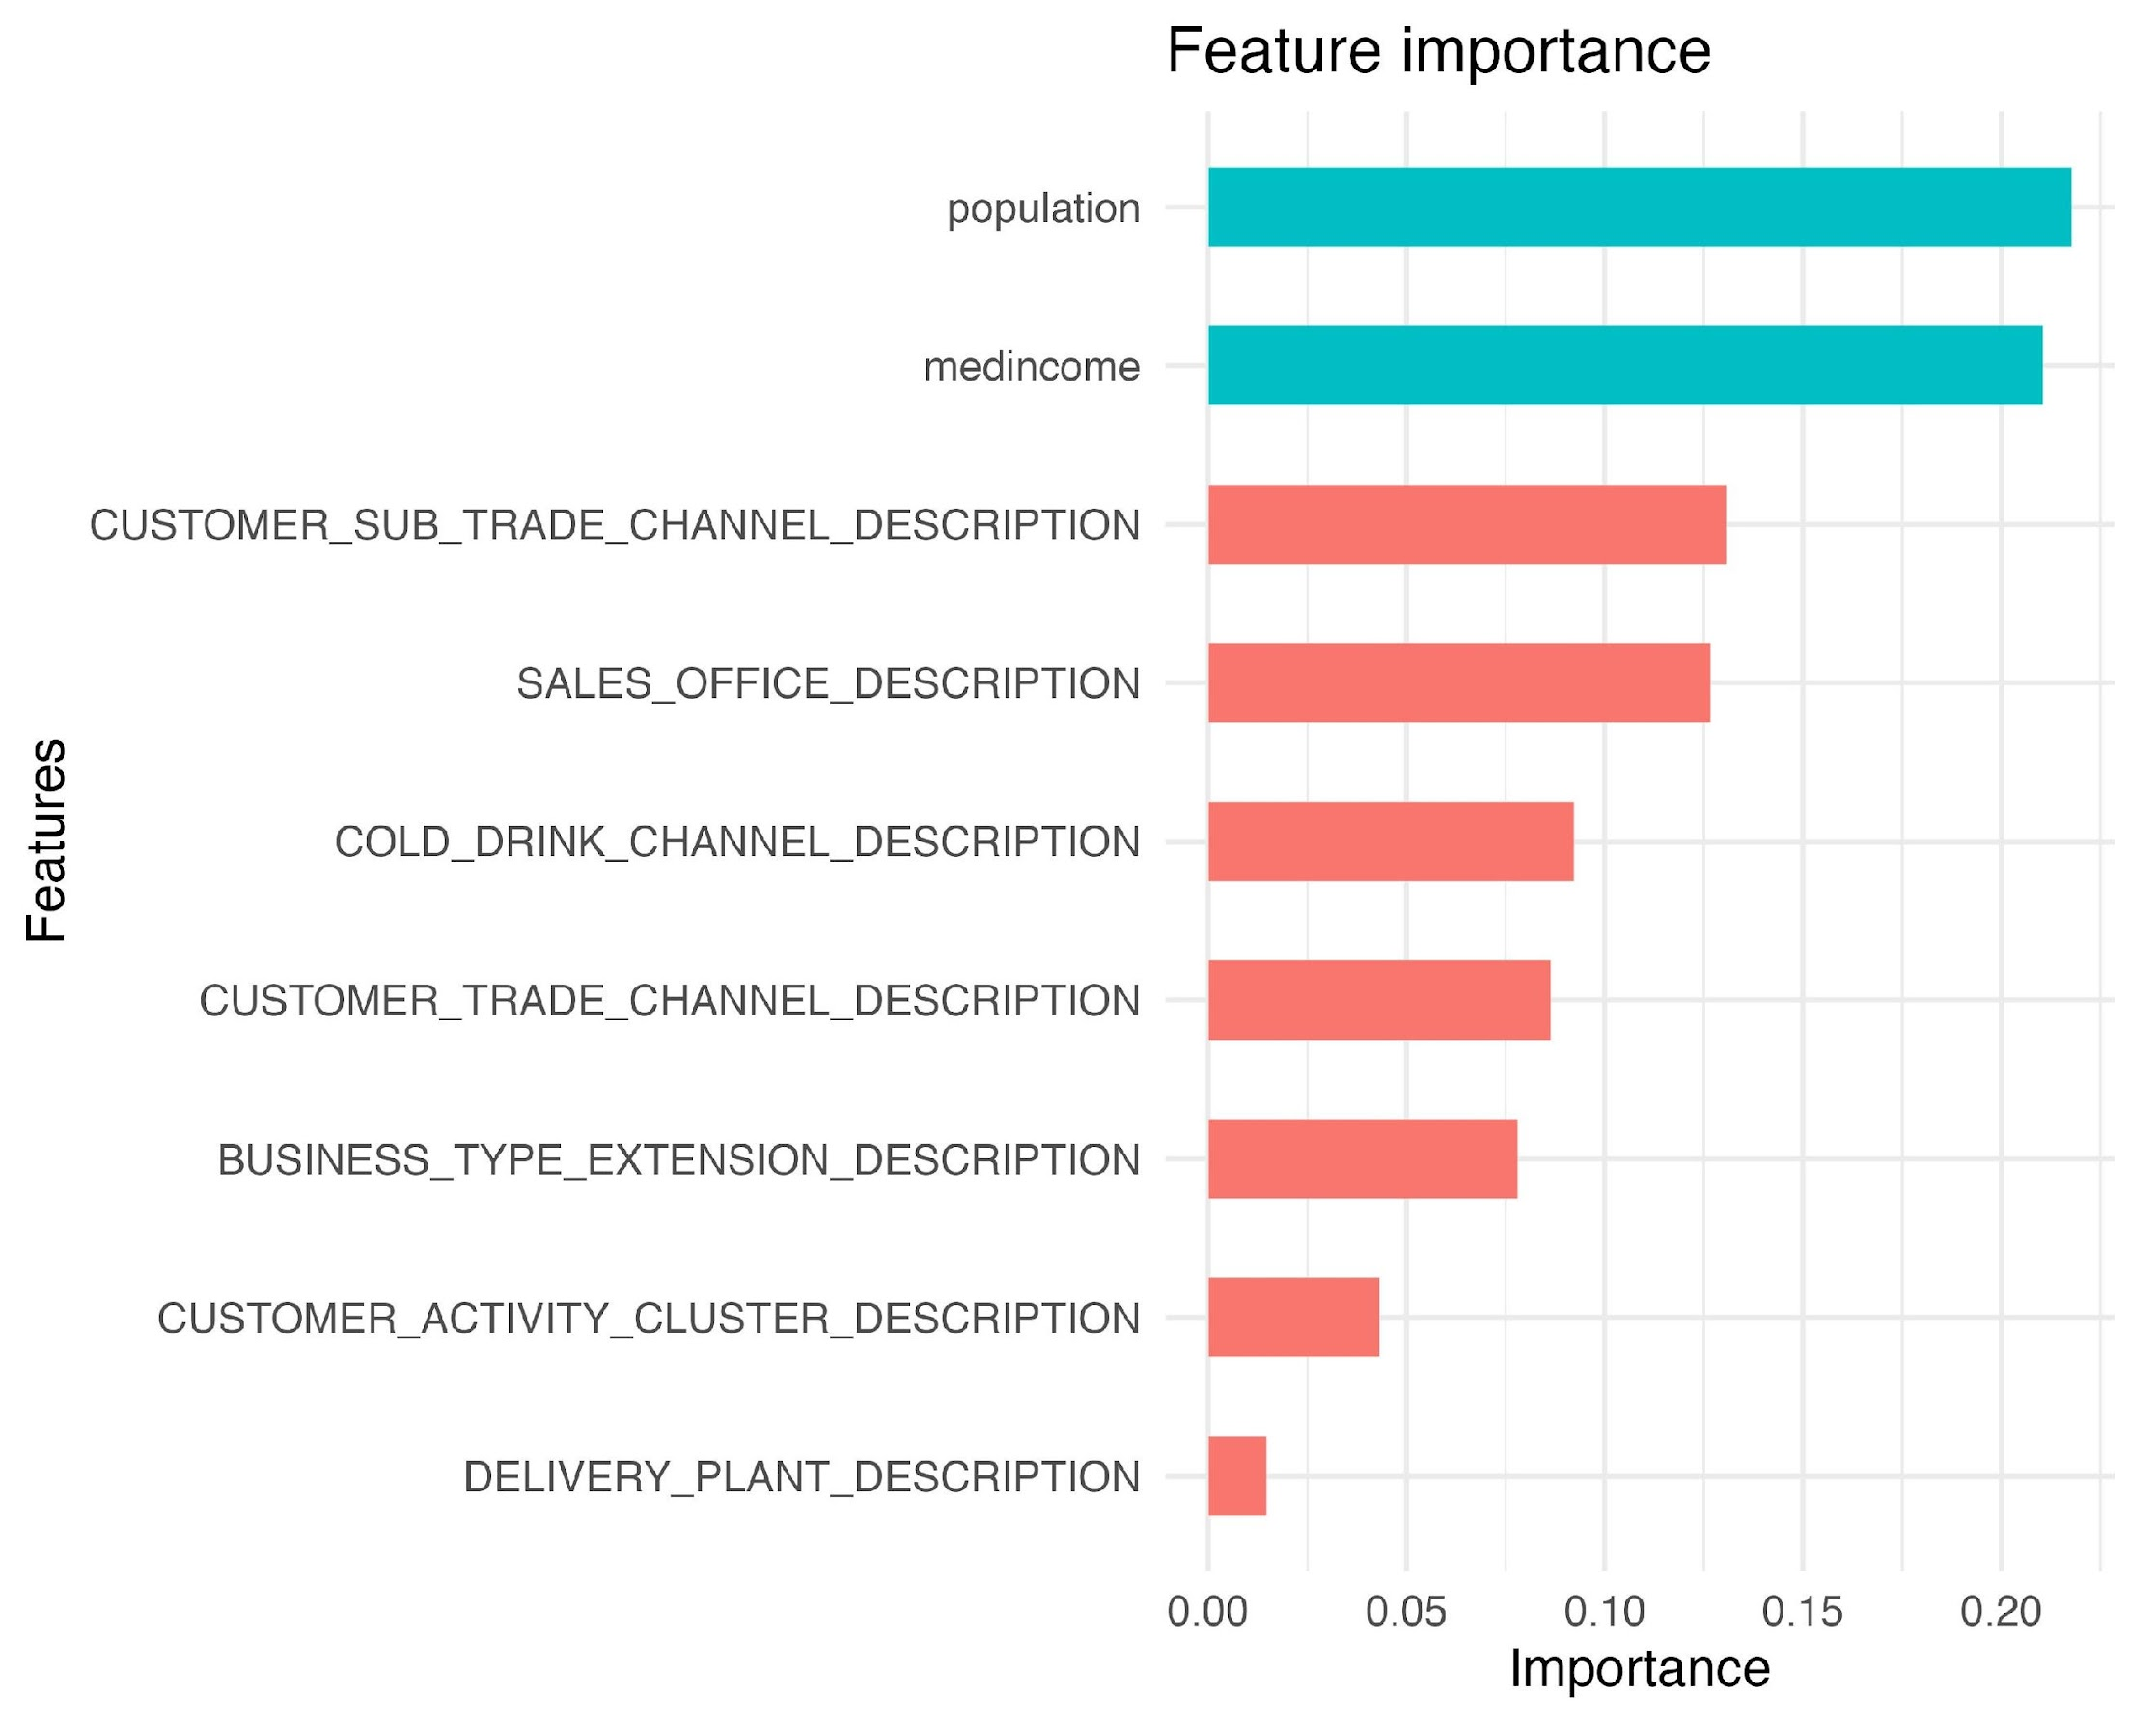
Model Deployment
Notes:
Joey
As the model is performing better than random guessing, we would suggest swire to use the model and continues to optimize the model by adding more outside data such as social economic data like median income and population. Out of the 10 variables that we have used for the model, median income, population, and customer trade channels were the most important predictors. It indicates that the current customer data does not have much impact in predicting the customer tiers, and we may need more outside data to help improve the predicting power.

Slide 8
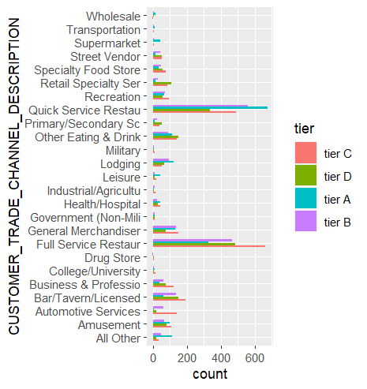
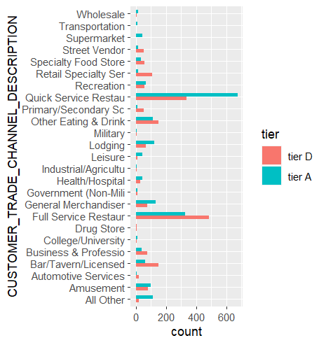
Recommendations
Classify potential customers.
Maximum and minimum discounts for each tier.
Certain Trade Channels are more common in different tiers.
Notes:
Nik
Classify potential customers using factors we previously highlighted.
For each tier, we recommend setting guidelines for max and min discounts that sales can offer.
A and B tier customers are more likely to generate more revenue - offer greater discounts for these businesses
Conversely, we recommend establishing maximum discount levels C & D tier custom
Some customer trade channels were over and underrepresented in each of the tiers. Some customer types, such as quick service and full-service restaurants, had the greatest variation when it comes to success.
One of the ways Swire could leverage our current model is to classify each potential customer using the features we previously mentioned. For each tier, we recommend establishing guidelines for the maximum and minimum discounts that sales teams can offer. Since A and B tier customers are more likely to generate more revenue, Swire should be willing to offer greater discounts to secure these businesses. Conversely, there should be a maximum discount level for C and D tier customers given their decreased likelihood of generating successful revenue.

Slide 9


Next Steps
Incorporate additional demographic data.
Use review data to assess customer perception.
Notes:
One of the main takeaways from our findings is that the population your customers serve makes a big impact on potential sales. Certain markets and population characteristics should definitely be considered when assessing partnerships with new clients. Socioeconomic variables such as
We attempted to correlate our data with customer reviews, but had some challenges with the blinded data set. It would be much easier to assess customer reviews with access to your data to see if there is a relationship between average reviews and potential revenue.
Because some additional external data is needed to draw valuable conclusions, we have a few ideas for further improving the model. Since the variables with the greatest correlation were both external, an interesting continuation would be

Slide 10


Limitations
Model trained on post-pandemic era.
Performance could be improved.
Notes:
Nik
One of the most common limitations of a point in time evaluation such as this investigation is the fact that biases from the data are represented in the final model. One of the most clear limitations is that the sales data is from the pandemic era which means these classifications may not be generalizable to current market conditions.

Slide 11
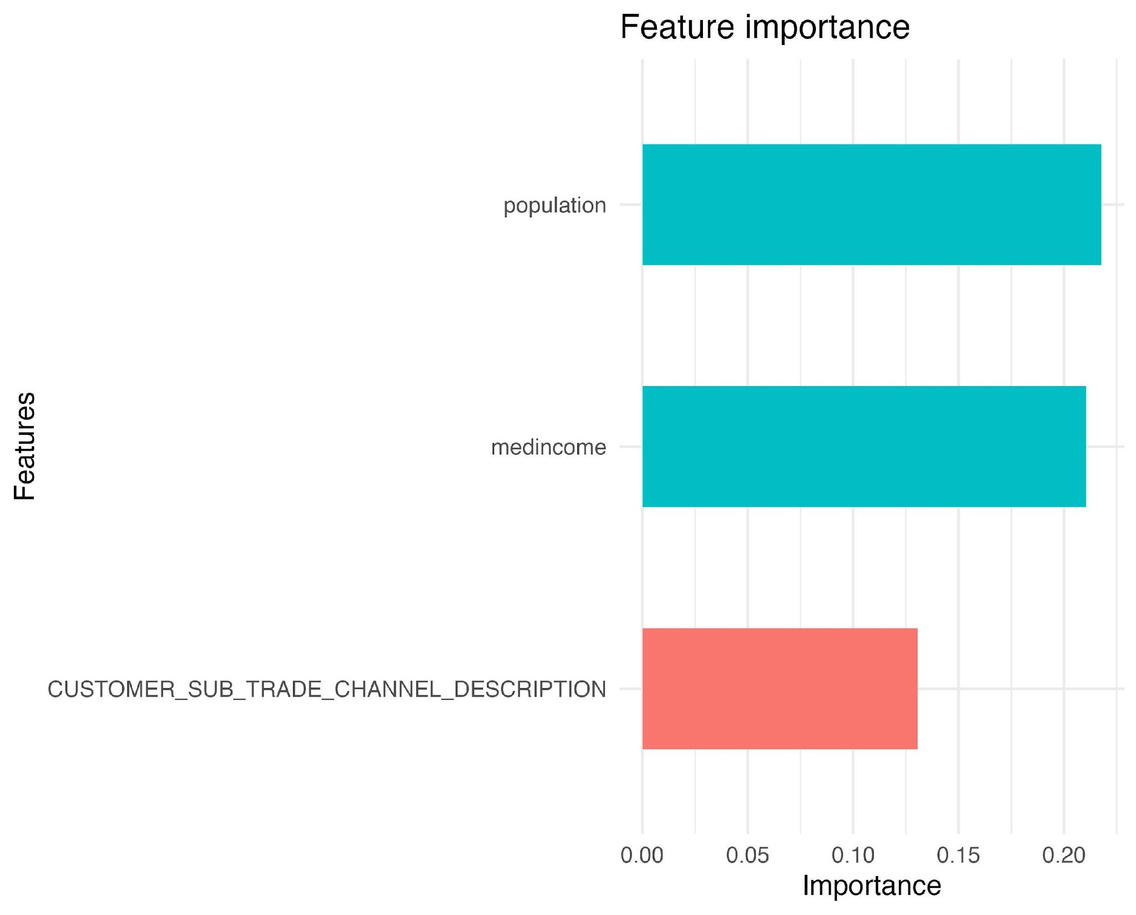
Executive Summary
Problem
Onboarding customers is a large investment
What makes a customer successful?
Solution
Assign tier to customers based on performance: A through D
Develop predictive model based on customer tier
Results
3 variables with greatest impact on customer tier: higher median income, higher population, trade channels such as supermarkets, wholesalers, and restaurants
Next Steps
Incorporate additional demographic data from external sources
Include review data to assess customer perceptions of clients
Limitations
Model trained on post-pandemic market conditions
Model performance could be improved
Notes:
Chase:
Problem
Understanding successful customers is critical
Large investment with an opportunity for sunk costs
In order to capitalise on ROI, we want to find a way to identify successful customers
Solution:
Tier customers by their total invoice price: A-D
We then trained a model to predict a customers tier
Results:
With accuracy greater than that of random chance, we determined that the model was useful
The most impactful variables were Higher Median Income, Higher Population, and some trade channels like supermarkets
We would recommend utilizing this tiering model to segment the customer base and leverage costs and discounts on those tiers
Next Steps:
We would further recommend incorporating additional demographic information to further provide context on customer differences
We would also want to find a way to integrate customer reviews to speak to the popularity aspect of the problem
Limitations:
With the model trained on post-pandemic market conditions, it would be prudent to retrain the model with more up to date information to reflect the changing market
This would help to increase the performance of the model and better classify successful customers
Thanks!

Slide 12
Questions?

Slide 13
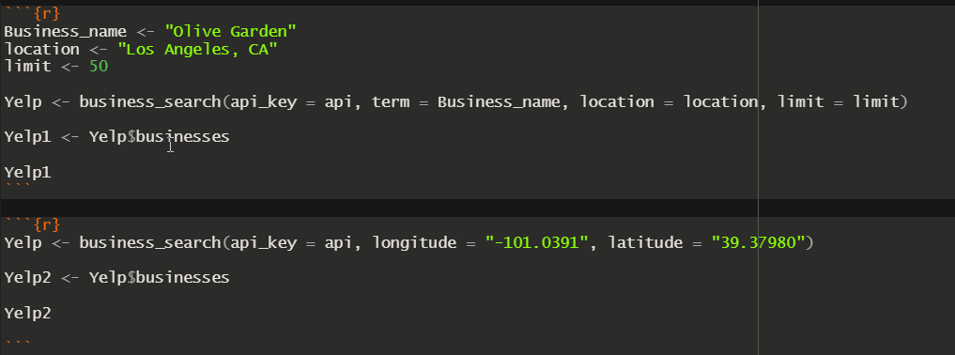
Appendix
Notes:
id, alias, name, image_url, is_closed, url, review_count, categories, rating, coordinates.latitude, coordinates.longitude, transactions, price,address, phone

Slide 15
Executive Summary
Onboarding customers is a large investment
Tier customers in 4 categories of success
Most important variables are:
Population
Median income
Sub Trade Channel
Limitations
Room for further investigation
Notes:
Chase
Understanding successful customers is critical

Slide 16
Business Problem
How do we best identify what a successful business is?
There is no defined criteria for what a makes a successful business, so creating a way to measure customer success is vital.
The approach we took started with identifying characteristics of current successful customers with a high yield of Invoice Price.
We chose to model customer success using Customer Tiering alongside predictive analytics.
Notes:
Chase
With 10% of their business coming from the performance of local businesses,
Swire Coca-cola is looking for a way to determine which potential customers will
be the most successful. With a method in place to predict the success of
customers, Swire will be able to select the best businesses to sell too.
This will allow for Swire to set prices that benefit both themselves and the
businesses and also maximize potential ROI. There are not any immediate success
metrics that we can measure, so determining success will take some time.
However, after a certain amount of time, success can be determined by the
revenue and traffic the store brings in.
The main focus of this project is to assist Swire Coca-Cola in identifying successful potential business partners.
With a sizable amount of business coming from the performance of local companies, it is important to identify current and predict future successful partners.
There is not a catch-all customer success metric, so creating a way to capture customer success is key to addressing the business problem at hand.

